Slide 1
Ant colony for a mixed optimisation problem
Operation research project
Student: Thomas Noguer
Supervisors: Jean-Charles Billaut
Nicolas Monmarché
M2RI CADS, 2014

Slide 2
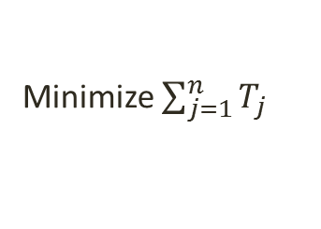
Introduction
Combined routing and scheduling problem
M1
1
2
3
M2
1
2
3
Minimize $\sum_{j=1}^{n}{T_{j}}$
NP-Hard

Slide 3
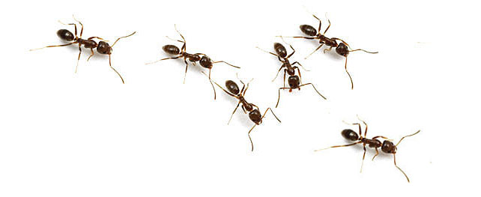







Introduction
Ant colony metaheuristic
$$x_{i}$$
${}_{i}^{4}$ = 0
$x_{i}^{7}$ = 1
$x_{j}^{17}$= 1
$$x_{j}$$
$x_{j}^{3}$= 1

Slide 4
Contents
Formalization of the problem
Ant colony optimization
General definitions
Application to the combined routing and scheduling problem
Heuristics
Results
Perspectives

Slide 5
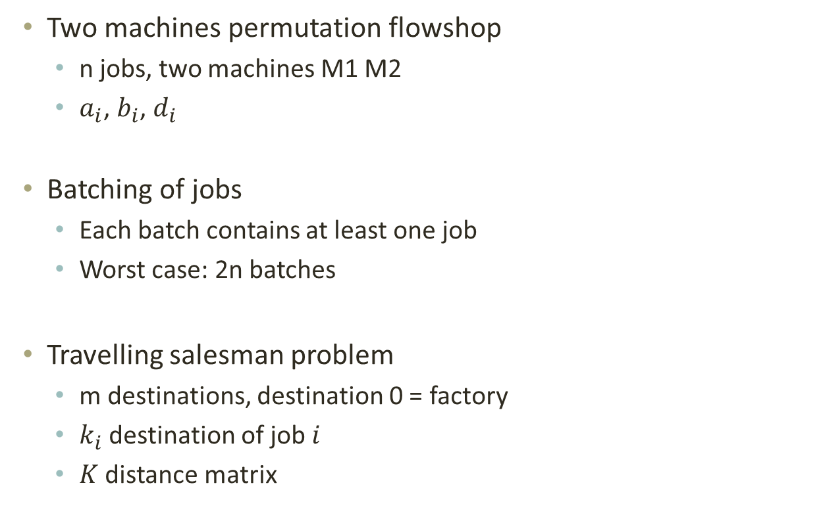
Formalization of the problem
- Formalization of the problem
- Ant colony optimization
- General definitions
- Application to our problem
- Heuristics
- Results
- Perspectives
Two machines permutation flowshop
n jobs, two machines M1 M2
$a_{i}$, $b_{i}$, $d_{i}$
Batching of jobs
Each batch contains at least one job
Worst case: 2n batches
Travelling salesman problem
m destinations, destination 0 = factory
$k_{i}$ destination of job $i$
$K$ distance matrix

Slide 6



Formalization of the problem
- Formalization of the problem
- Ant colony optimization
- General definitions
- Application to our problem
- Heuristics
- Results
- Perspectives
M1
1
2
3
M2
1
2
3
$$k_{2}$$
Solution:
1
2
3
2
2
1
1
3
0
$$k_{1}$$
$$k_{3}$$

Slide 7

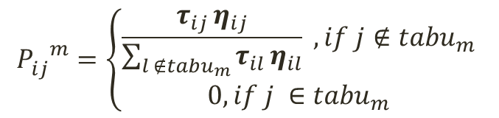
Ant colony optimization General definitions
- Formalization of the problem
- Ant colony optimization
- General definitions
- Application to our problem
- Heuristics
- Results
- Perspectives
Construction of a solution
2
1
3
Solution:
1 2 4 5 6 3
4
5
6
$${P_{ij}^{}}_{}^{m}=\left\{\begin{aligned}\frac{τ_{ij }η_{ij}}{\sum_{l ∉{tabu}_{m}}{τ_{il }η_{il}}} , if j∉{tabu}_{m} \\ 0, if j ∈{tabu}_{m}\end{aligned}\right.$$

Slide 8
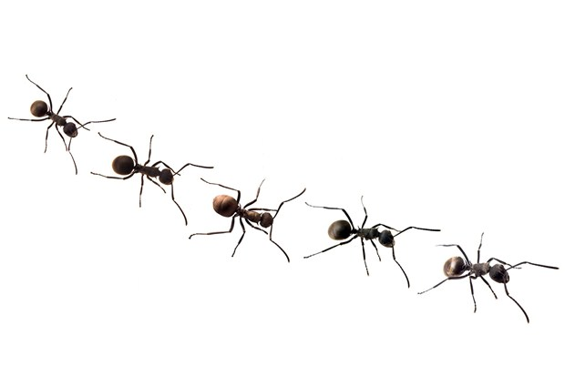
Ant colony optimization General definitions
- Formalization of the problem
- Ant colony optimization
- General definitions
- Application to our problem
- Heuristics
- Results
- Perspectives
For k ← 1 to iterationNumber do
For each ant do
Construct solution
Local pheromone update
End for
Local search
Global pheromone update
End for
Return Best found solution

Slide 9
Ant colony optimization Application to our problem
- Formalization of the problem
- Ant colony optimization
- General definitions
- Application to our problem
- Heuristics
- Results
- Perspectives
Graph representation impossible for the whole problem
Choose only one sub-problem
Flowshop
Batching
Batching
More central
Easy to deduce the rest of the solution

Slide 10
Ant colony optimization Application to our problem
- Formalization of the problem
- Ant colony optimization
- General definitions
- Application to our problem
- Heuristics
- Results
- Perspectives
2
1
3
Batches
{2,4} {5,6,3}
4
5
6

Slide 11
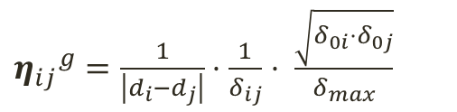



Ant colony optimization Application to our problem
- Formalization of the problem
- Ant colony optimization
- General definitions
- Application to our problem
- Heuristics
- Results
- Perspectives
M1
1
2
3
M2
1
2
3
${η_{ij}}^{g}=\frac{1}{\left|d_{i}−d_{j}\right|}⋅\frac{1}{δ_{ij}}$ $⋅ \frac{\sqrt{δ_{0i}⋅δ_{0j}}}{δ_{max}}$
$$k_{2}$$
$$k_{1}$$
$$k_{3}$$

Slide 12
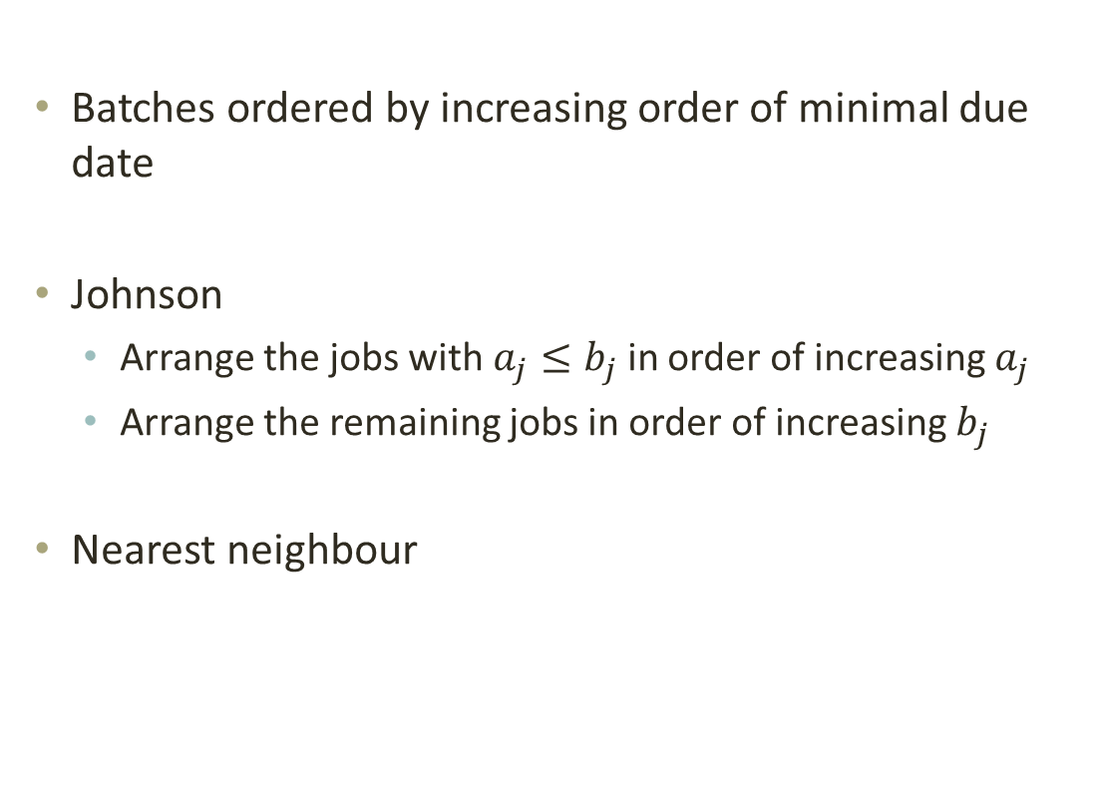
Heuristics Finish building the ant colony solution
- Formalization of the problem
- Ant colony optimization
- General definitions
- Application to our problem
- Heuristics
- Results
- Perspectives
Batches ordered by increasing order of minimal due date
Johnson
Arrange the jobs with $a_{j}≤b_{j}$ in order of increasing $a_{j}$
Arrange the remaining jobs in order of increasing $b_{j}$
Nearest neighbour

Slide 13
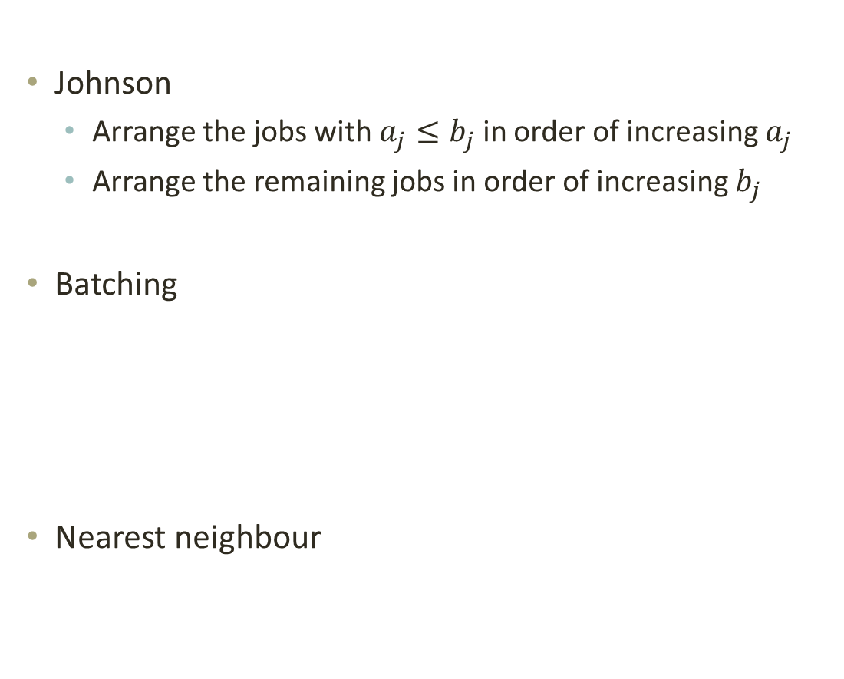
Heuristics Build a solution out of nothing
- Formalization of the problem
- Ant colony optimization
- General definitions
- Application to our problem
- Heuristics
- Results
- Perspectives
Johnson
Arrange the jobs with $a_{j}≤b_{j}$ in order of increasing $a_{j}$
Arrange the remaining jobs in order of increasing $b_{j}$
Batching
Nearest neighbour
M1
1
2
3
M2
1
2
3

Slide 14
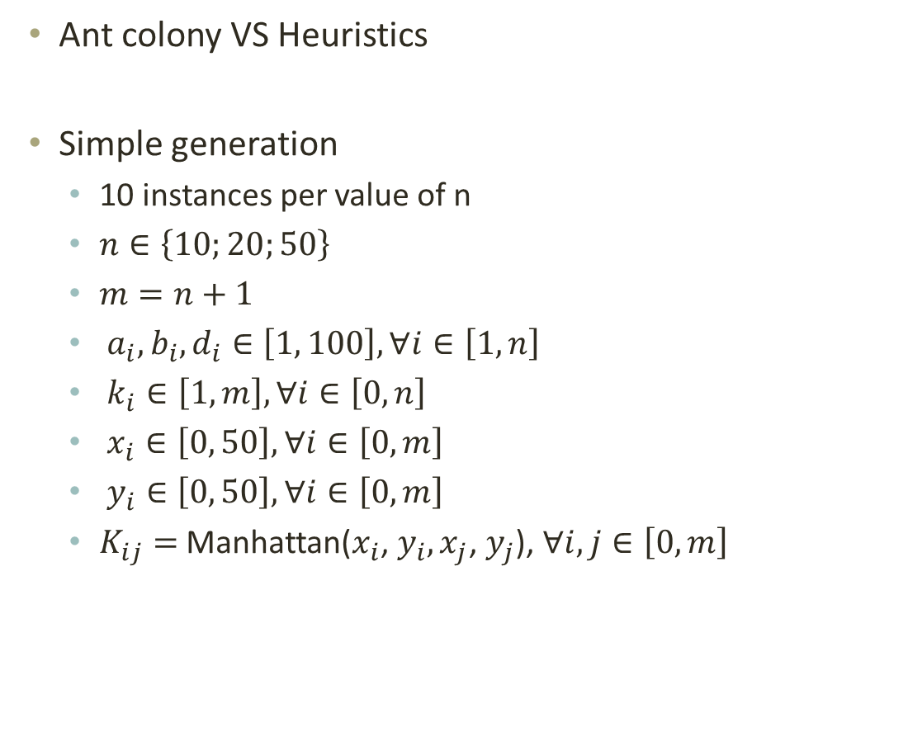
Results
- Formalization of the problem
- Ant colony optimization
- General definitions
- Application to our problem
- Heuristics
- Results
- Perspectives
Ant colony VS Heuristics
Simple generation
10 instances per value of n
$n∈\left\{10;20;50\right\}$
$m=n+1$
$a_{i},b_{i},d_{i}∈\left[1, 100\right], ∀i∈\left[1, n\right]$
$k_{i}∈\left[1, m\right], ∀i∈\left[0, n\right]$
$x_{i}∈\left[0, 50\right], ∀i∈\left[0, m\right]$
$y_{i}∈\left[0, 50\right], ∀i∈\left[0, m\right]$
$K_{ij}=$ Manhattan($x_{i}$, $y_{i},x_{j}\text{,} y_{j}$), $∀i,j∈\left[0, m\right]$

Slide 15
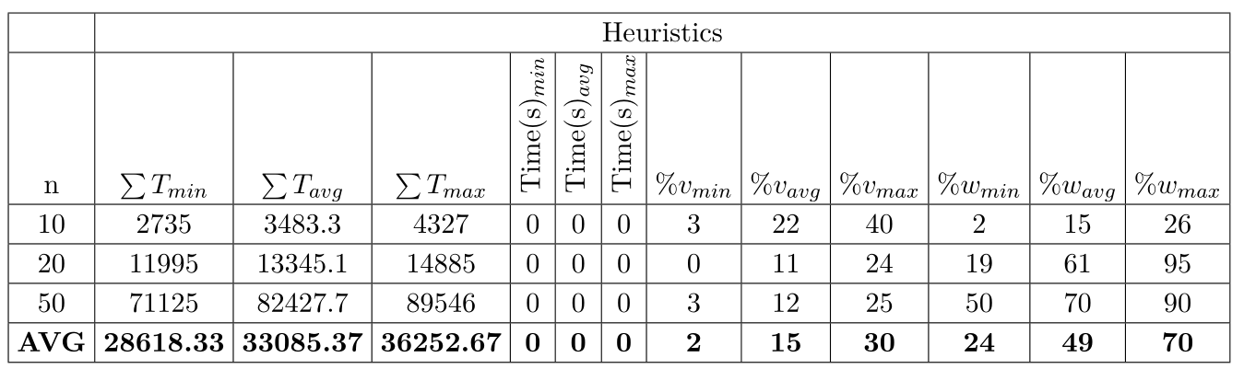
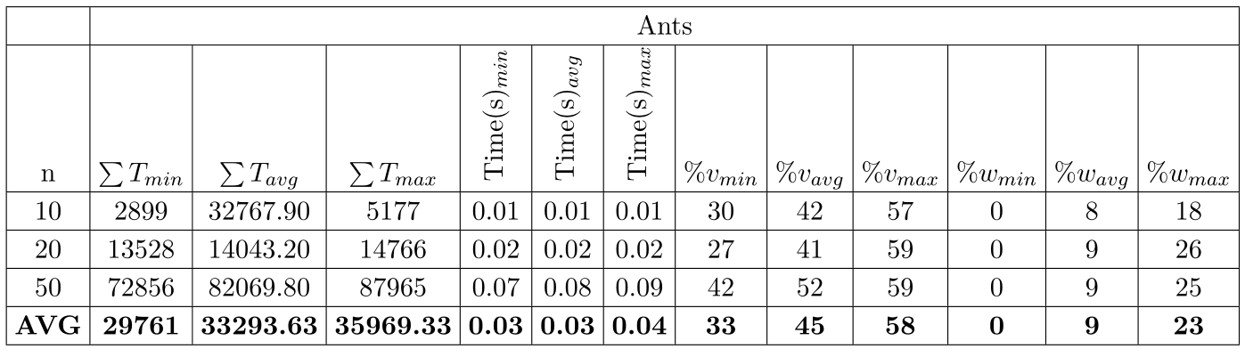
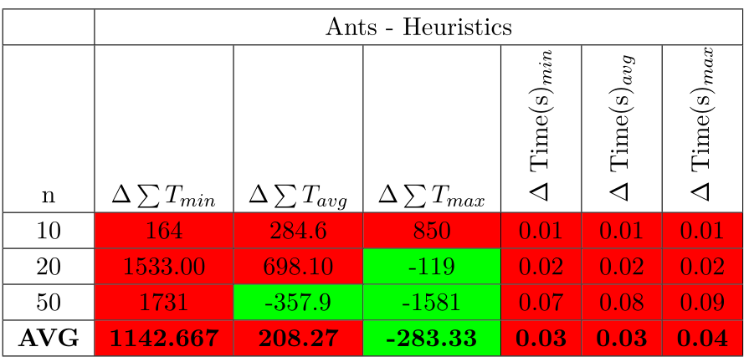
Results
- Formalization of the problem
- Ant colony optimization
- General definitions
- Application to our problem
- Heuristics
- Results
- Perspectives

Slide 16
Perspectives
- Formalization of the problem
- Ant colony optimization
- General definitions
- Application to our problem
- Heuristics
- Results
- Perspectives
Tune the parameters of the ant colony
Local search
Study of the instances and the solutions with the idle times
Use the ant colony on the flowshop
Use different metaheuristics

Slide 17
Conclusion
Application of the ant colony
Work on a combined problem
Short amount of time
ROADEF conference

